Slide 1
Checkpoints

Slide 2
Introduction
The DBMS checkpoint is a procedure of compressing the transaction log file by transferring the old transaction to permanent storage. It helps in system recovery when the failure occurs. The procedure of system recovery includes reading of log file in reverse order and maintaining redo and undo lists.

Slide 3
In a real-time environment, a newly created transaction log file occupies an ample amount of storage space. A transaction log file contains a record of operations performed by the transactions in the database. They ensure consistency on crashes or hardware failures. Tracing every single update and maintenance of log files also contributes to filling up the system's memory. The DBMS checkpoint come into the picture when the size of the transaction log file becomes too large to manage and handle easily. The DBMS checkpoint is a mechanism of compressing the transaction log file by transferring the old transactions to permanent storage. The checkpoint marks the position till where the consistency of the transactions is maintained. During the execution of the transactions, the curser passes through the marked checkpoint. At that point, all the transactions get saved into the database and get erased from the log file. Then the log file started getting filled up by some new list of operations till the next checkpoint.

Slide 4
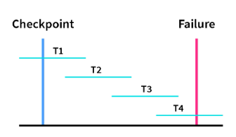
Recovery using Checkpoint
The schematic representation of the system recovery when the failure occurs during the execution of concurrent transactions.

Slide 5
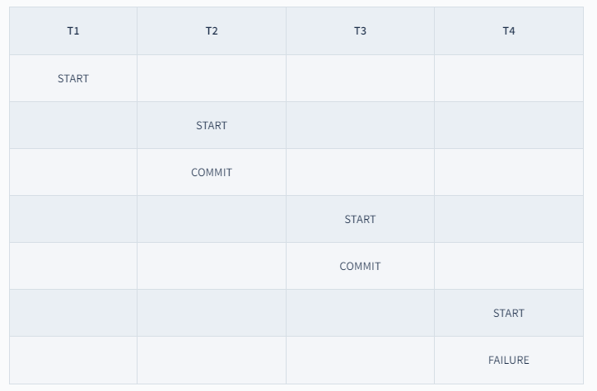
Transactions and their operations in the above diagram:

Slide 6
Following are the steps to be performed for the system recovery using checkpoint.
The transaction log file are read in the reverse order, ie., from T4 to T1.
Redo and Undo are the lists that are created and maintained by the system.
If the transactions contain operations like <Tn, start> and <Tn, commit> together or <Tn, commit> alone then the transaction will be stored in the redo list. In the above diagram, The transaction T1 contains only <Tn, commit> and transactions T2 and T3 contain <Tn, start> and <Tn, commit> both the operations and therefore transactions T1, T2 and T3 are stored in the redo list.
If the transactions contain operations like <Tn, start> but not <Tn, commit>, then the transaction will be stored in undo list. In the above diagram, The transaction T4 contains <Tn, start> but not <Tn, commit> operation, and therefore transaction T4 is stored in undo list.

Slide 7
Advantages
A checkpoint is a feature that enhances the consistency of the database during the execution of multiple transactions concurrently.
Checkpoint help in getting our transactions back in the case of accidental shutdown of the database.
Checkpoint hardens the dirty pages. Hardening dirty pages refer to writing all the dirty pages from log files or the buffer to physical disk.
Checkpoint serves as the synchronization point between the database and the transaction log file.
Checkpoint accelerates the data recovery process.
Checkpoint records in the log file avoid irrelevant redo operations.
The execution and the maintenance of the transaction log file become easier and simpler due to the continuous shifting of dirty pages from log files to permanent storage.

Slide 8


